Slide 1
PAYROLL SYSTEM
WITH RFID FOR
COMPUTER SYSTEMS INSTITUTE
Members :
Lester Sapaula
Sherwin Bordeos
Merriam Atun
Alexander Miranda

Slide 2
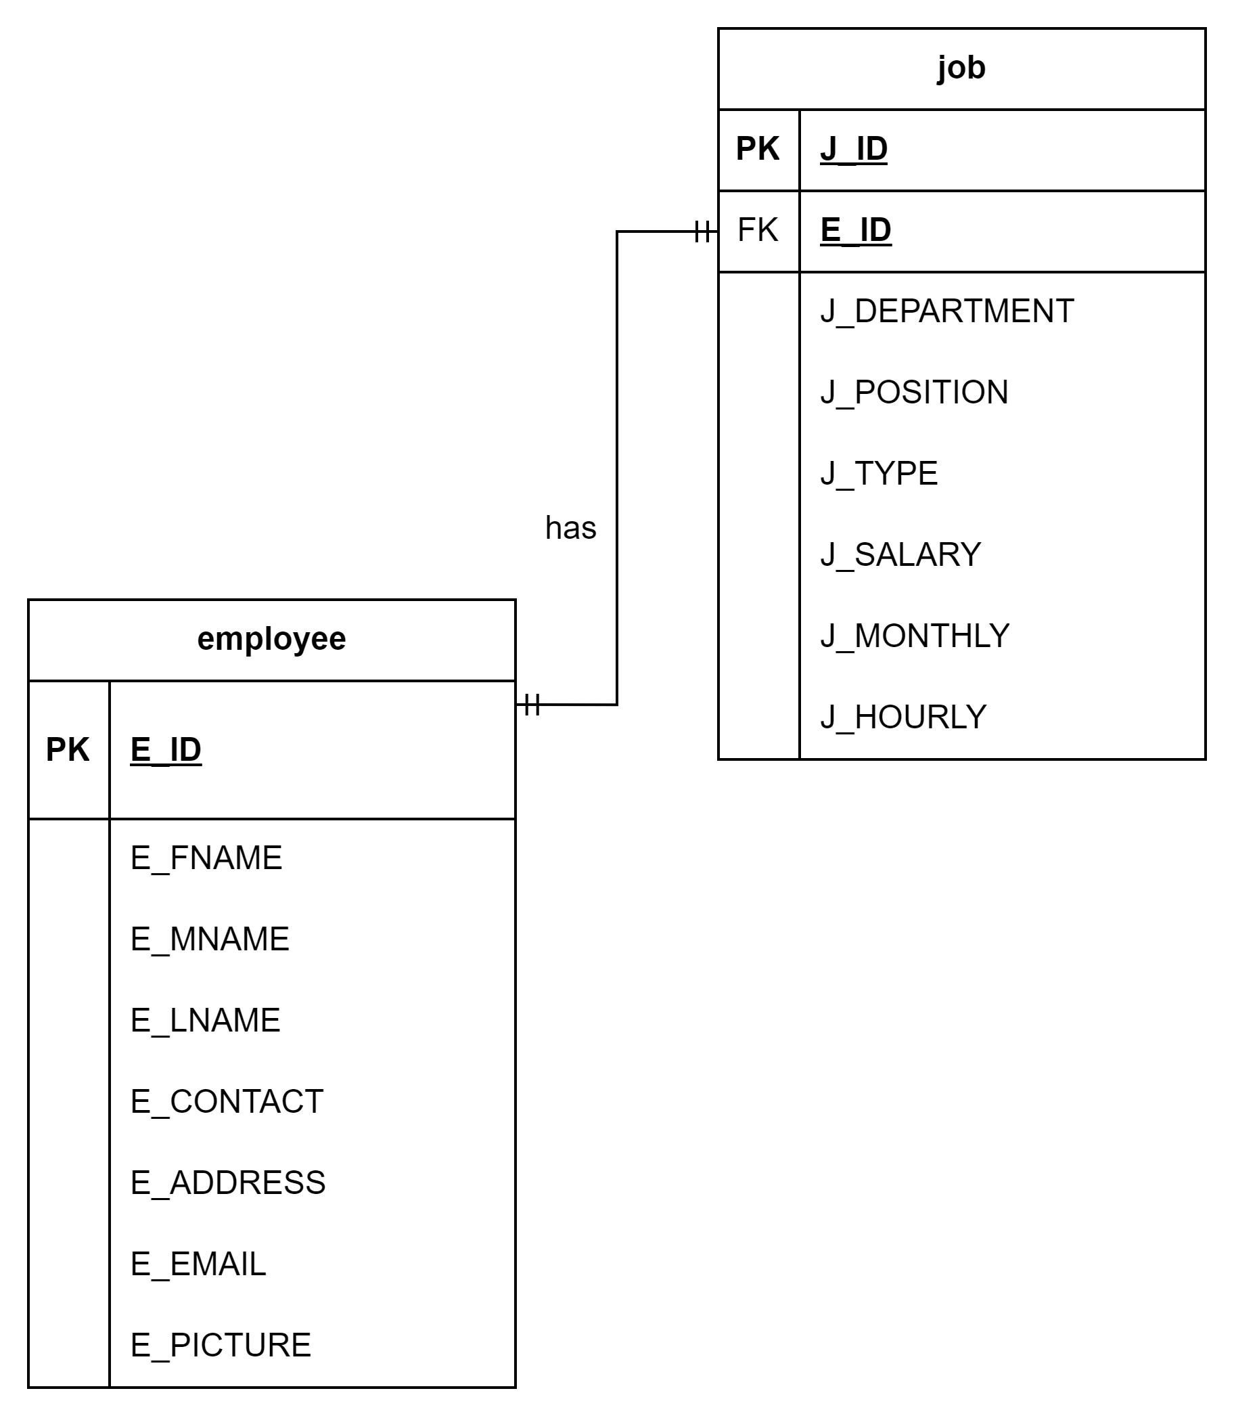
Payroll System with RFID
Business Rule:
The relationship between “job” and “employee” is that each employee has only one job department and job position. Therefore Employee entity has one and only one to Job entity.

Slide 3
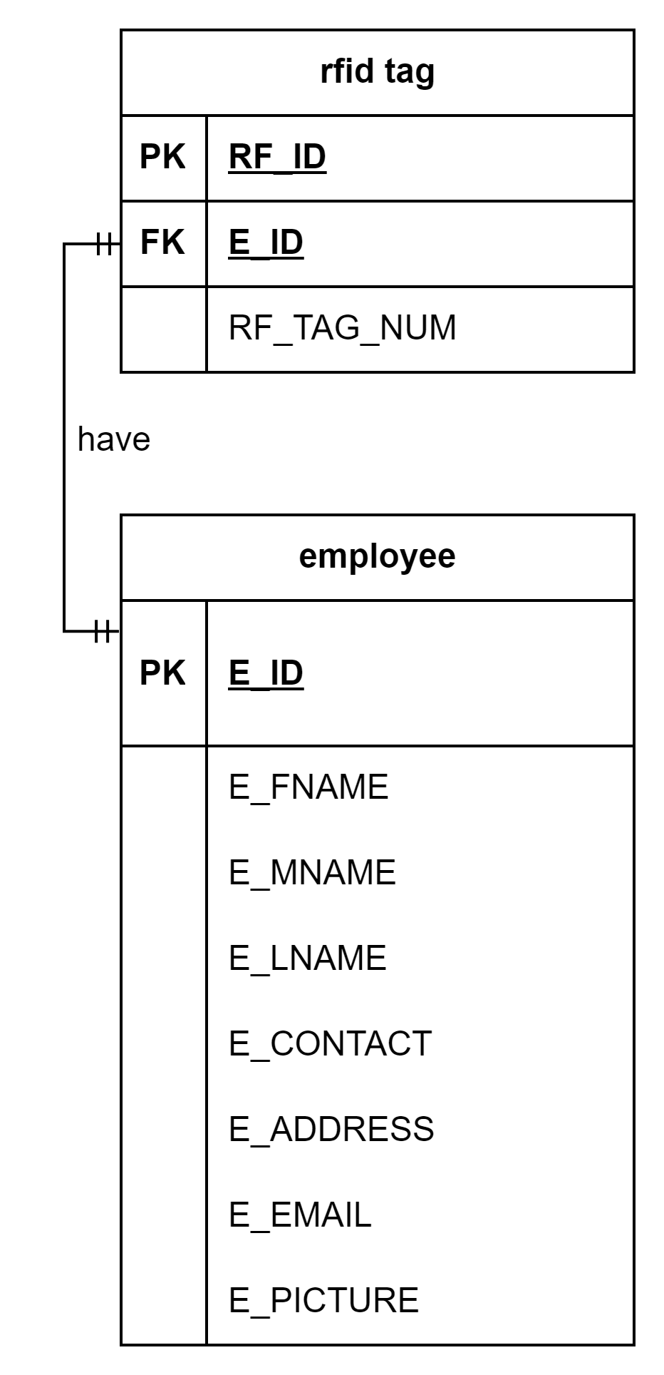
Payroll System with RFID
Business Rule:
A “employee” may only have one and only one “rfid tag”. Each “rfid tag” has a employee personal info.

Slide 4
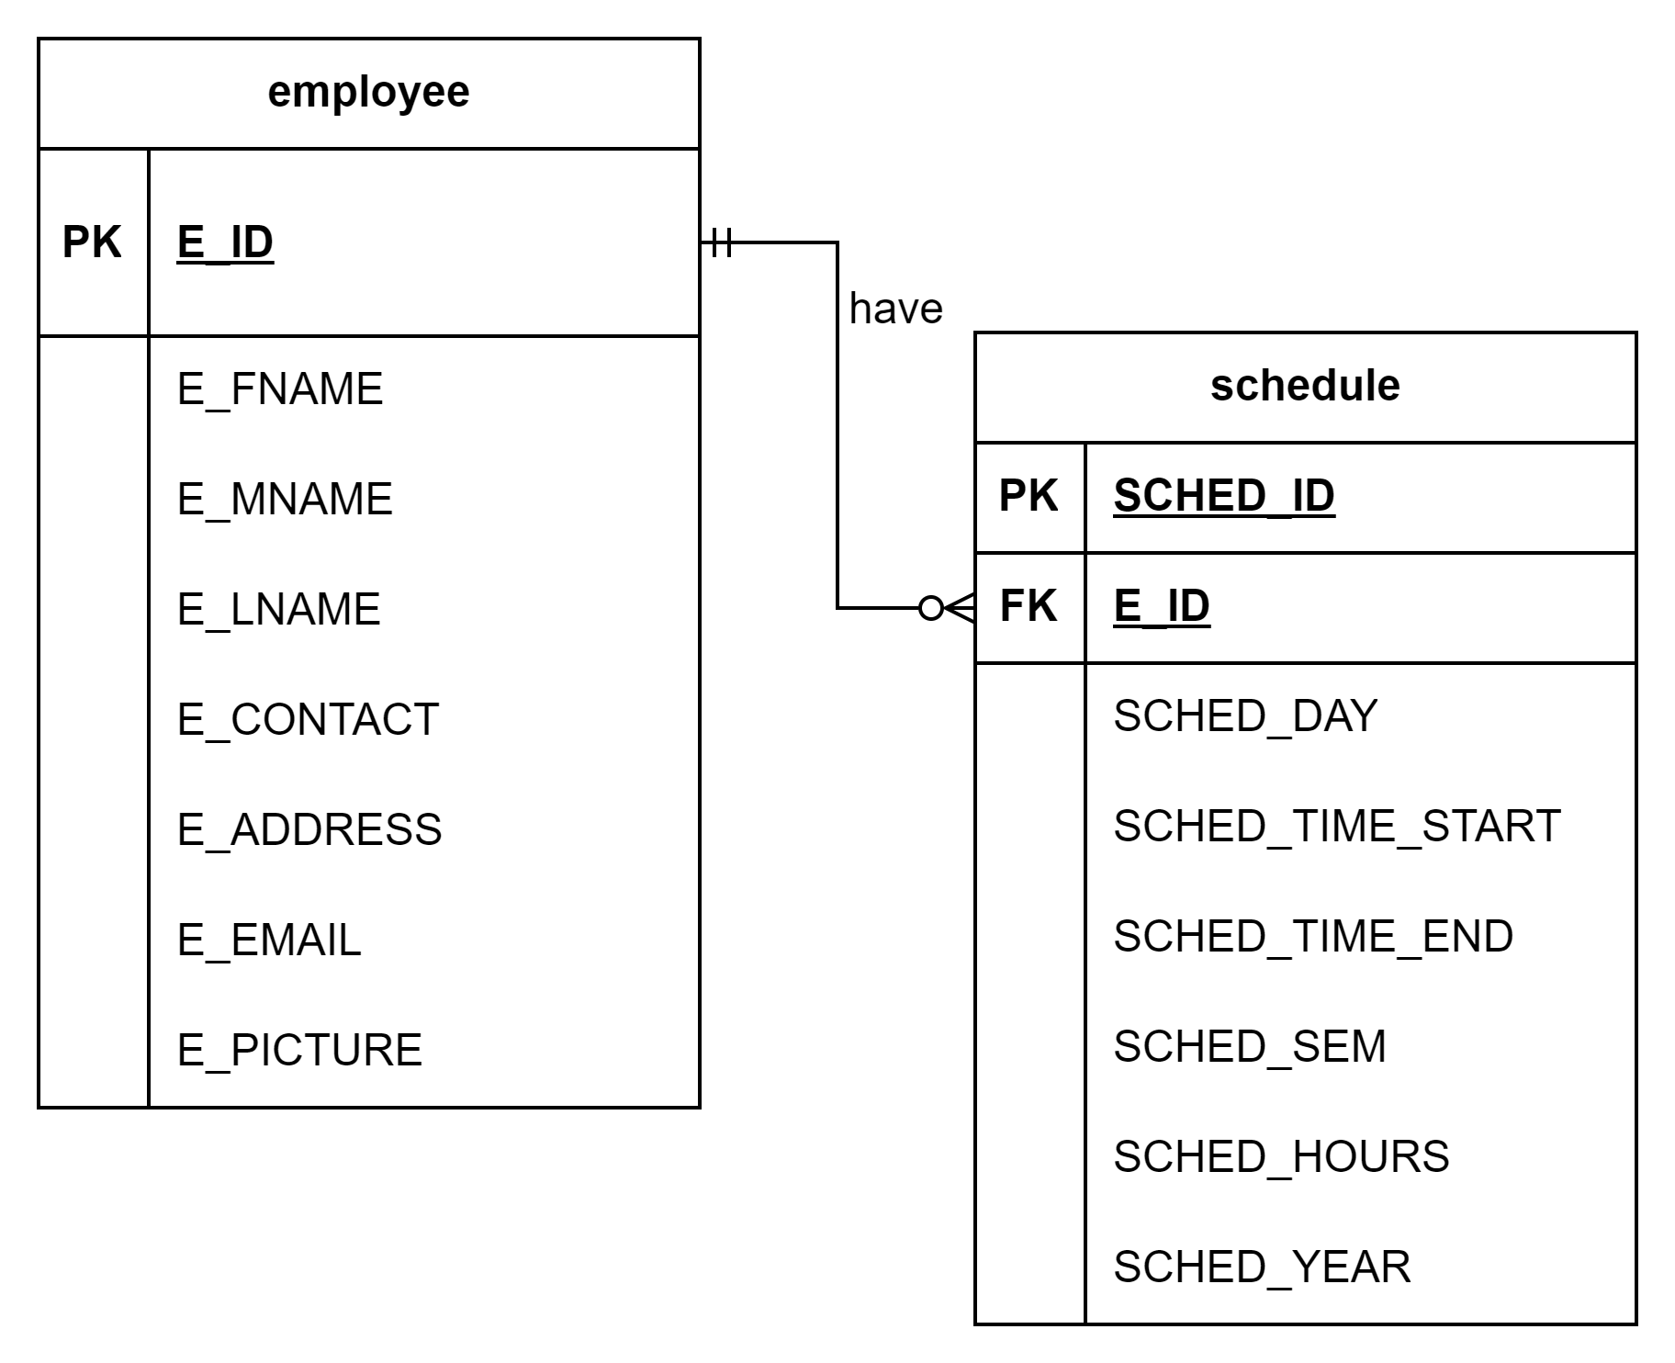
Payroll System with RFID
Bussiness Rule:
Each “employee” may have none or many “schedule” to attend per day. Example a employee such as teacher may have a class in the morning for 3 hrs and in the next afternoon he or she may have another class again for 3 hrs so he/she have schedule different schedule on the same day.

Slide 5
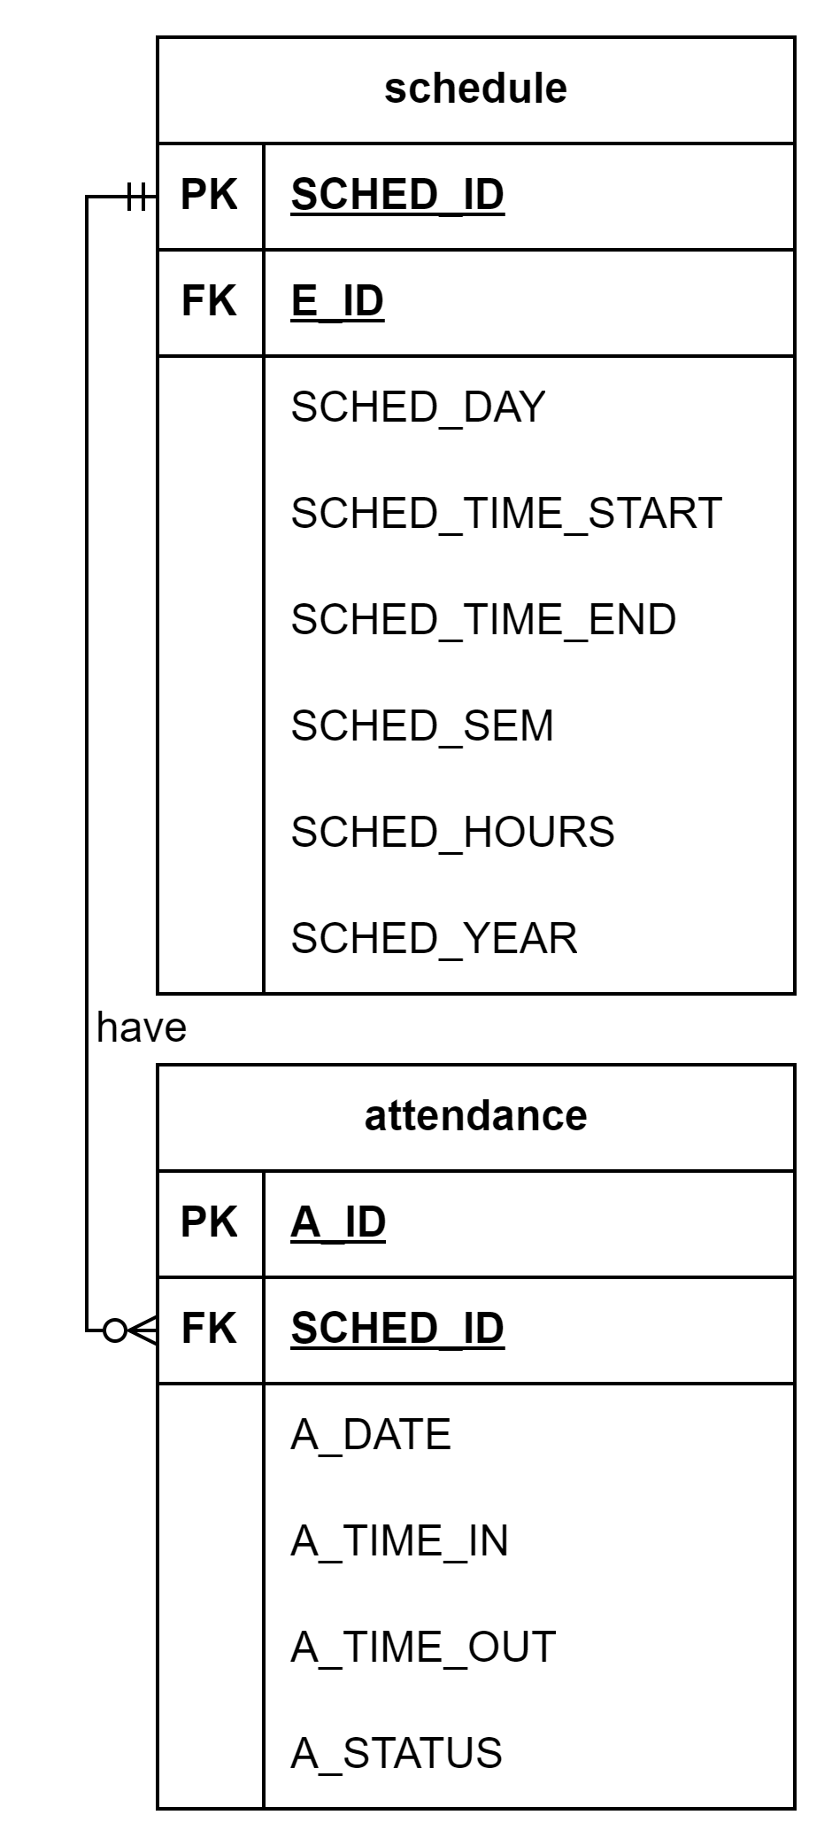
Payroll System with RFID
Business Rule:
Each “schedule” that a employee has, may have none or more “attendance” to enter in each day and time. Example the schedule is 8 am to 10 am, its either the attendance has a the exact same time in schedule, different time for being late or undertime, or else absent since the schedule is not followed in the attendance.

Slide 6
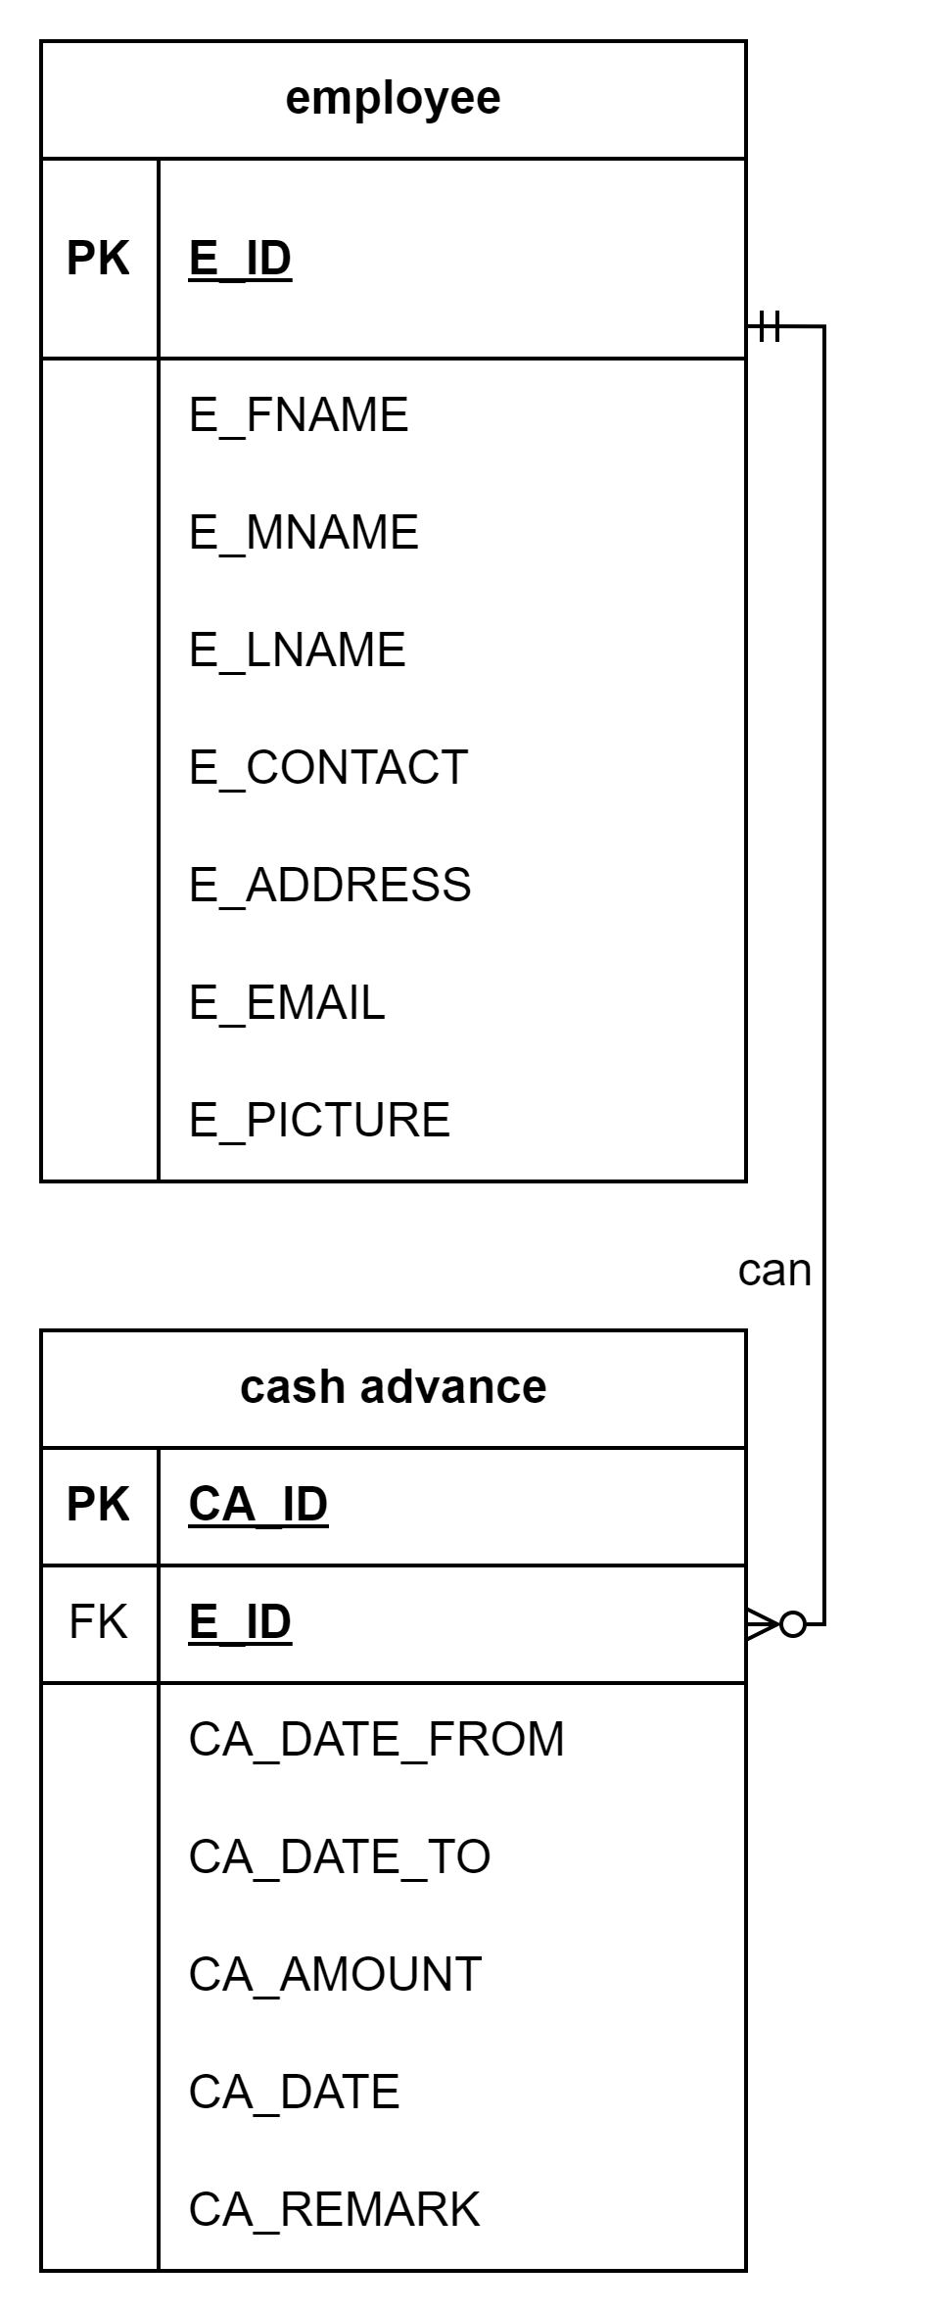
Payroll System with RFID
Business Rule:
Each “employee” can have a none or many “cash advance”. A employee decide whether they cash advance or not. Therefore Employee is optional to Cash Advances if an employee has cash advance.

Slide 7
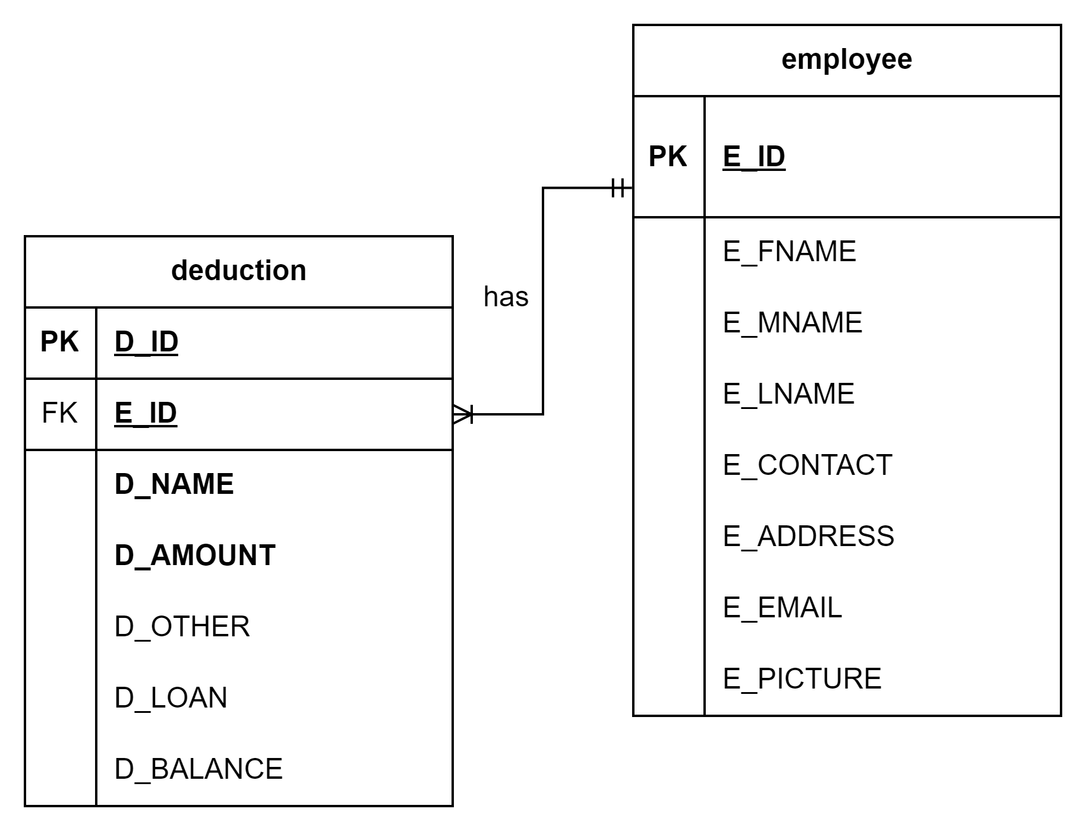
Payroll System with RFID
Business Rule:
Each “employee” may have one or many “deduction”. A employee has a deduction which is, the contribution that has a fix amount except the sss, loan from sss or, other deduction. Therefore Deduction has one or many to Employee.

Slide 8
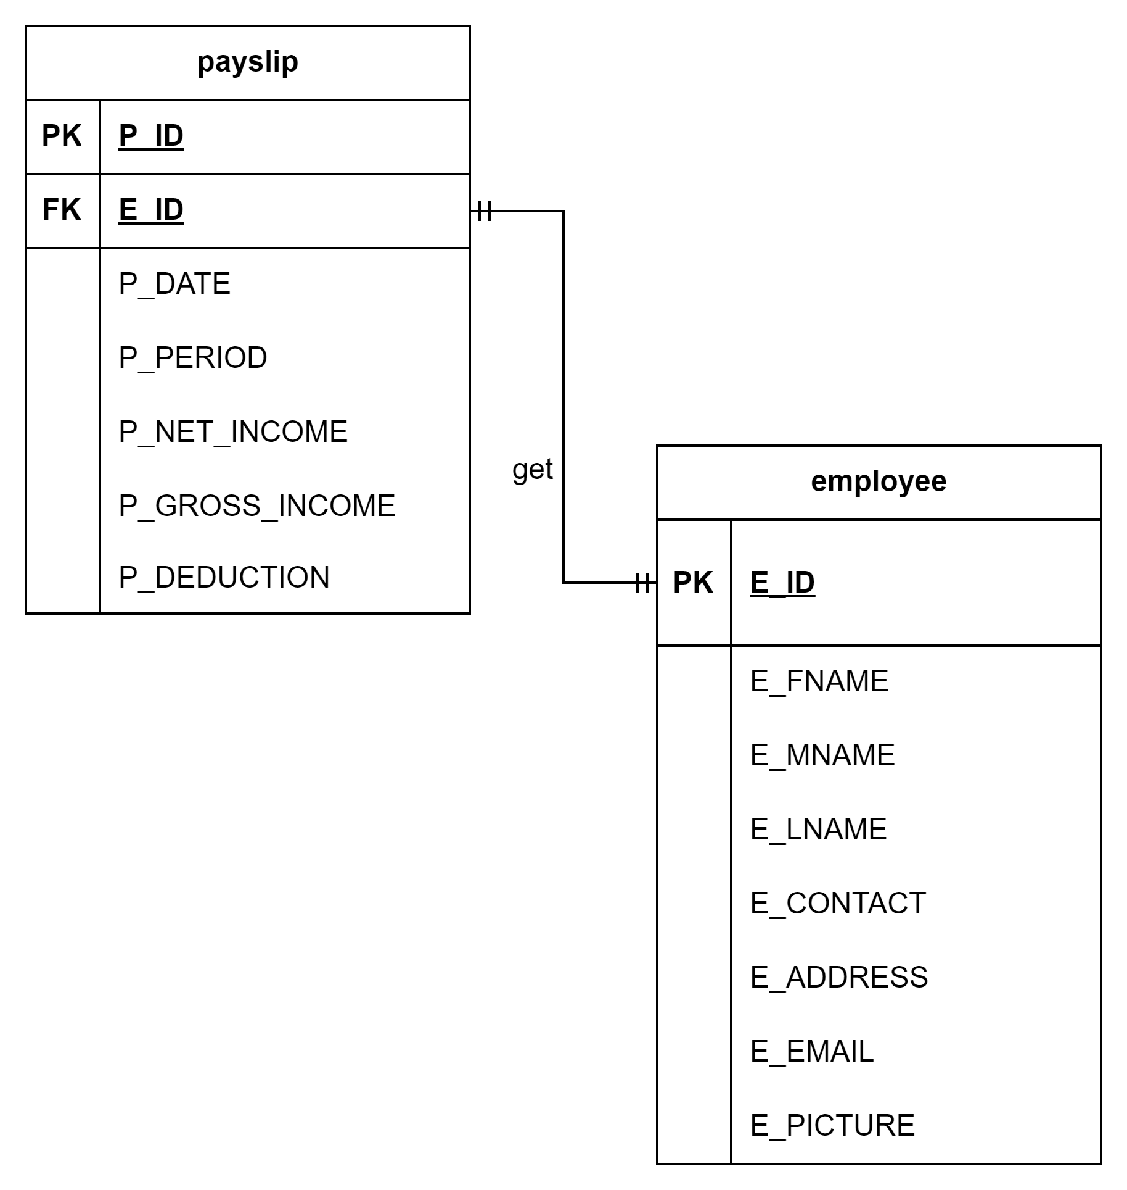
Payroll System with RFID
Business Rule:
The relationship of “employee” and “payslip” is a employee will get each a payslip every cut off, which is the 15th and 30th month pay. Therefore a Employee entity has a one and only one to Payslip entity.

Slide 9
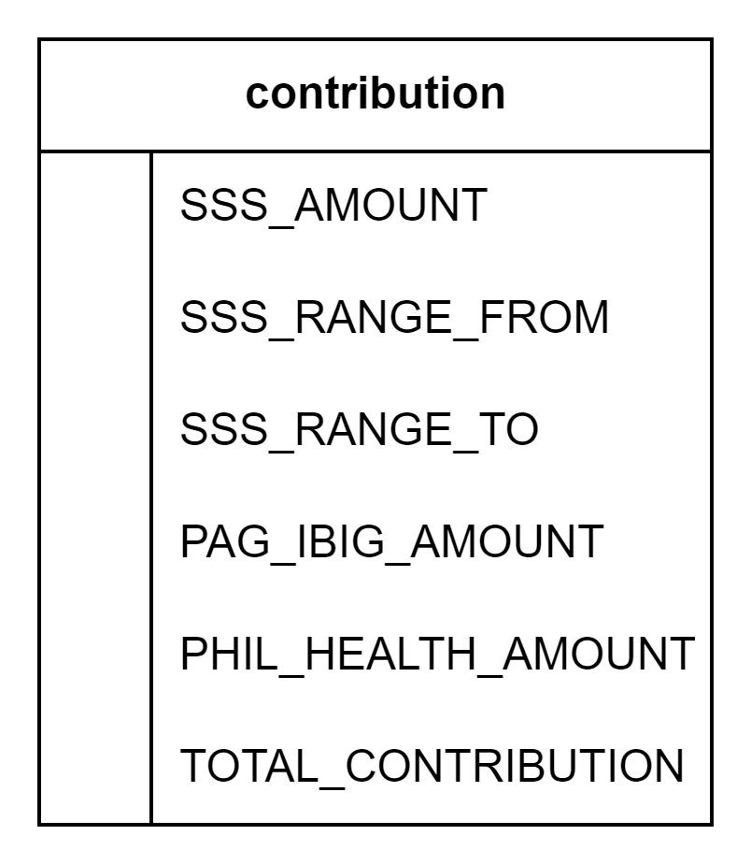
Payroll System with RFID
Business Rule:
Contribution is a hanging entity which only store a fix amount that will be use for computation in salary

Slide 10
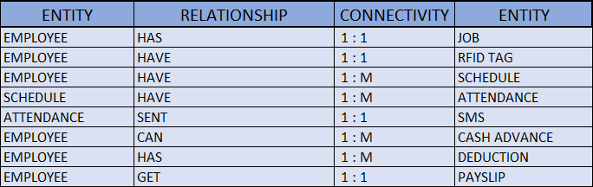
Components of the ERM

Slide 11
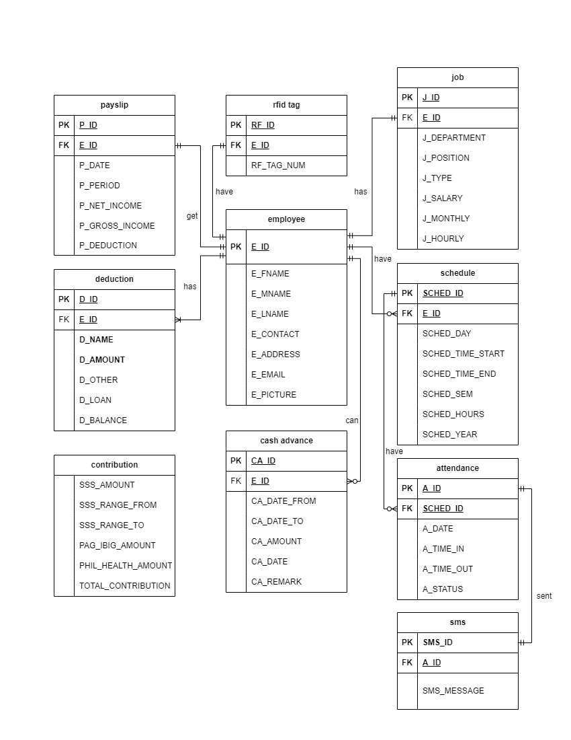
ERD

Slide 12
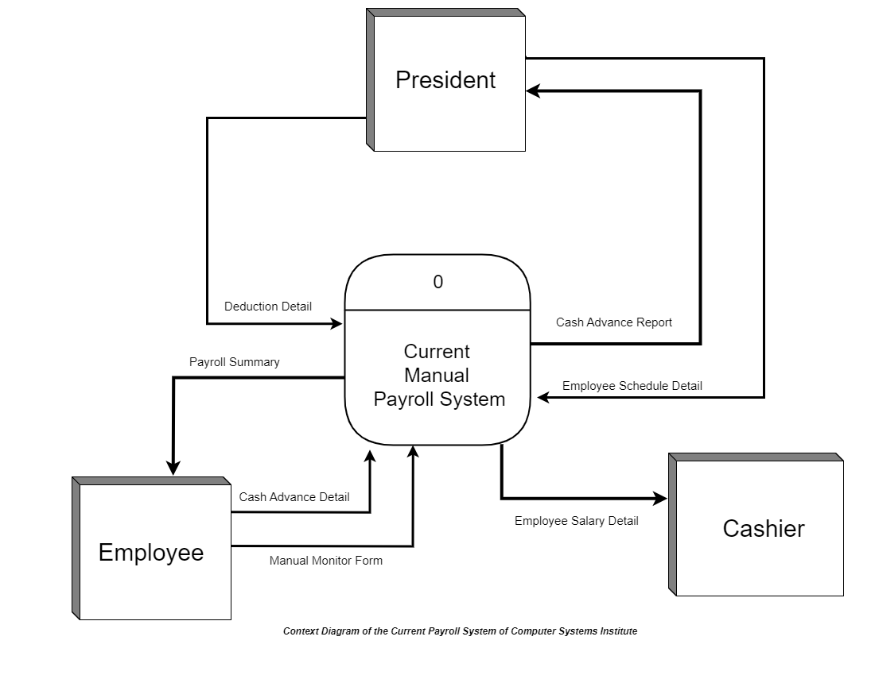
Context Flow Diagram of the Current Payroll System

Slide 13
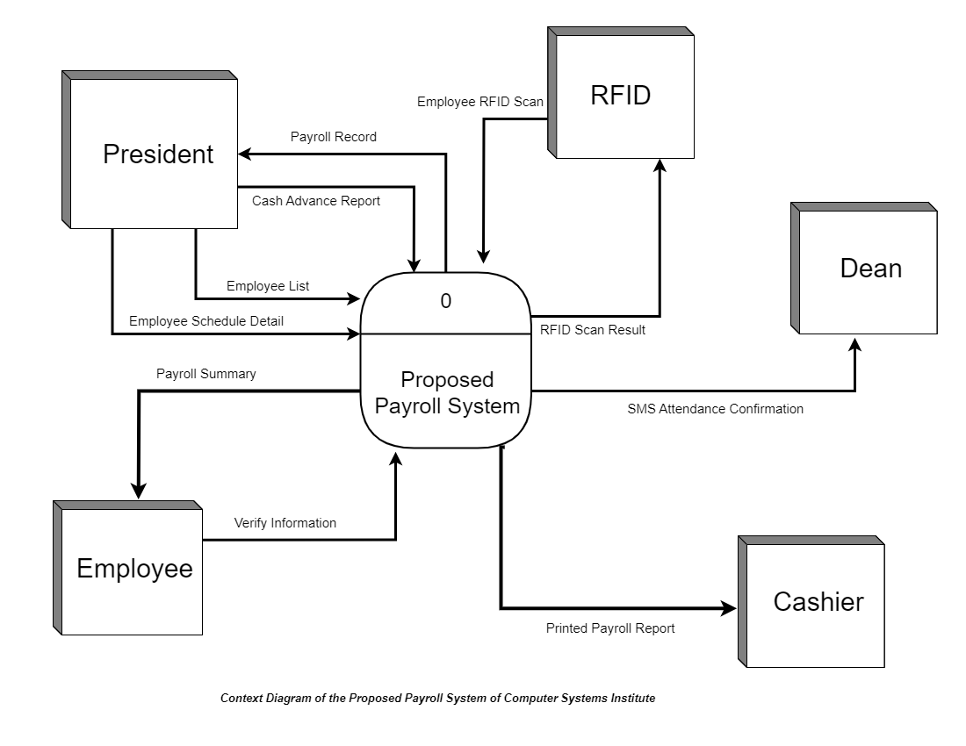
Context Flow Diagram of the Proposed Payroll System

Slide 14

Admin Log In

Slide 15
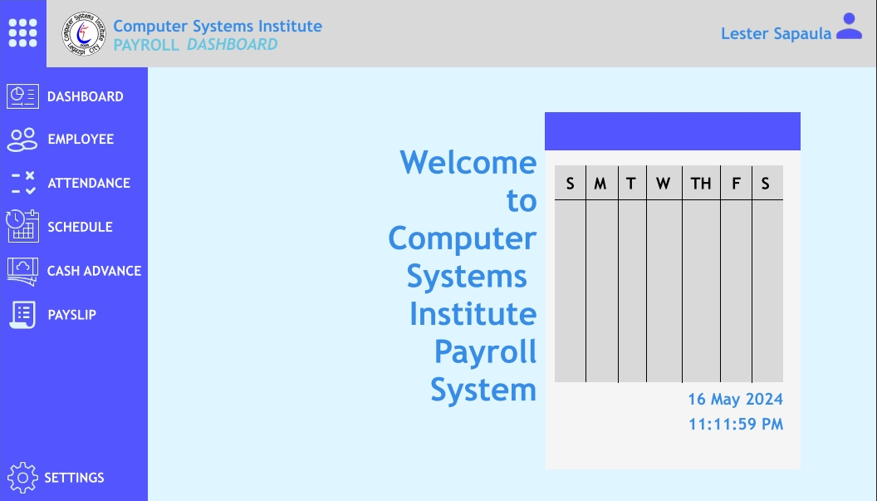
MAIN Dashboard
Dashboard is where the calendar and time can be seen in case a user don’t know the exact time and date also for him to be able to check it easier and faster rather than going to the desktop of computer.

Slide 16
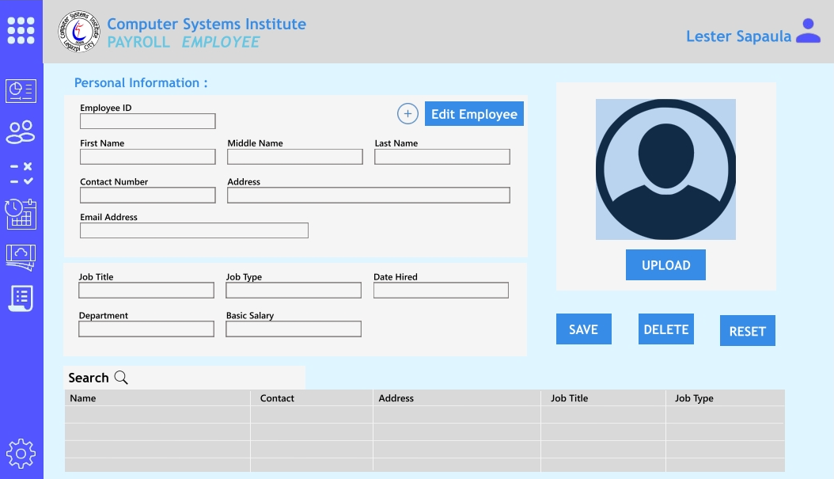
EMPLOYEE DASHBOARD
Employee Dashboard – this is where the admin user where he add, edit, delete the personal information of a employee.
Admin user also assign the employee their job type, job title, job department, job salary, and also the date they are hired.

Slide 17
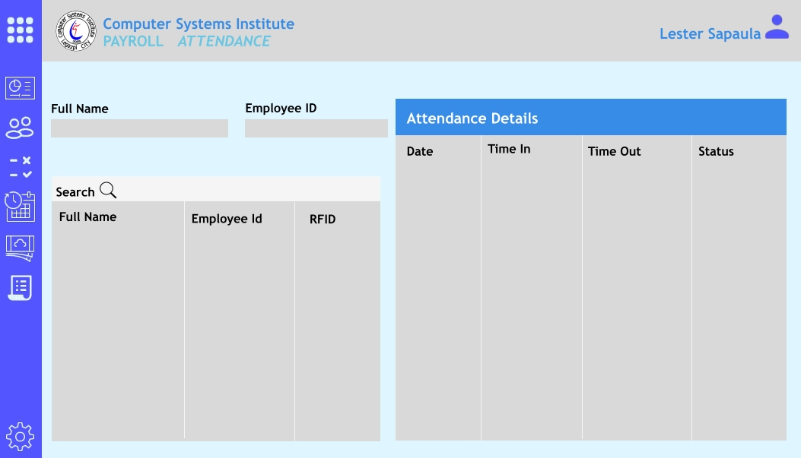
ATTENDANCE DASHBOARD
Attendance Dashboard – this is where the admin user can see the details about the attendance of a employee, he or she can select or search on which employee he/she wants to see their attendance.

Slide 18
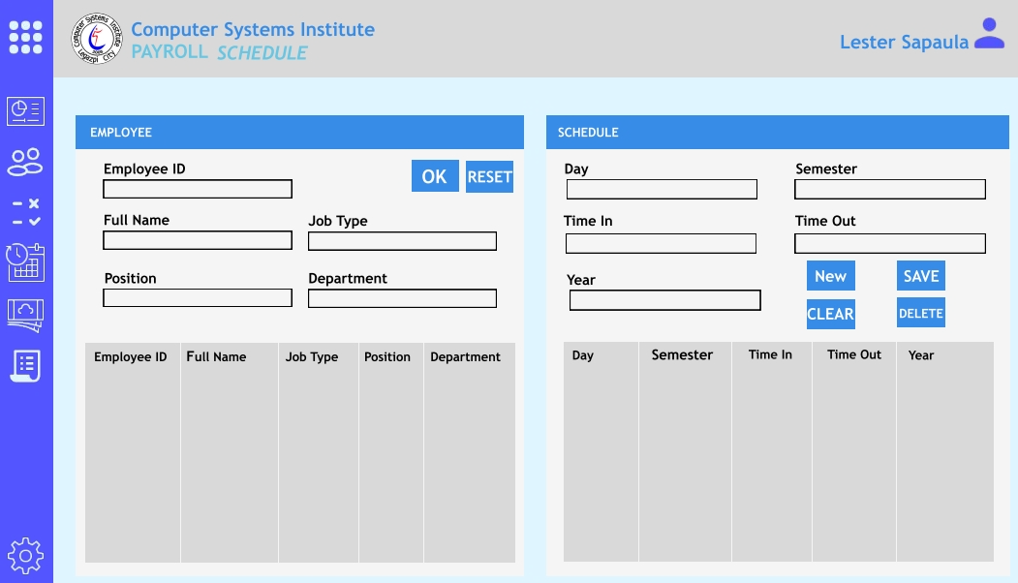
SCHEDULE DASHBOARD
Schedule Dashboard – is where an admin user assign an schedule for each employee. A admin must first select or search a employee for and after he/she can set a schedule for the employee. Admin can add new or delete schedule.

Slide 19
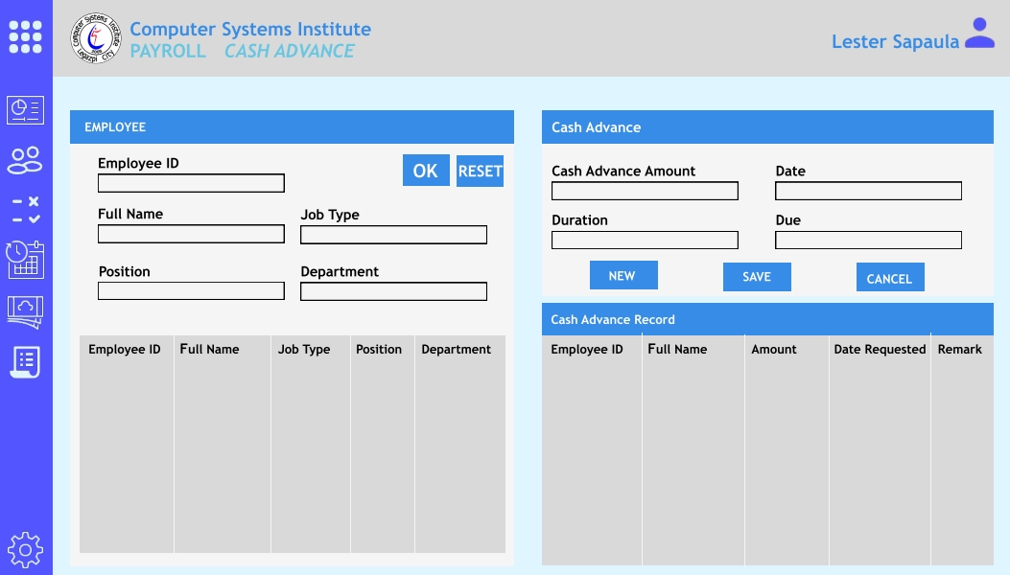
CASH ADVANCE DASHBOARD
Cash Advance Dashboard –
Is where a admin user input the cash advance of the employee. The admin must also select or search for the employee before inputting cash advance.

Slide 20
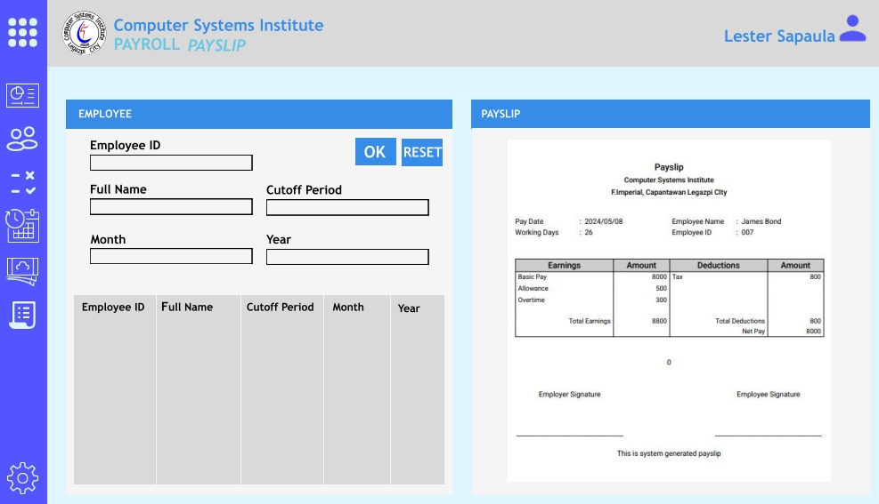
PAYSLIP DASHBOARD
Payslip Dashboard – is where the admin can generate the employee payslip. The admin must select the employee before generating and printing payslip.

Slide 21
Hardware Requirements for the Implementation of the System
- Intel Core i5-6200U
- 8GB RAM DDR4
- 512GB SSD
- Monitor 15" Display
- USB 2.0 Keyboard
- USB 2.0 Mouse
- RFID
- RFID Reader
- GSM Modem

Slide 22
Software Requirements for the Development of the System
Windows 10
Visual Studio C# version 2019
MySQL Workbench v8.0
MySQL DATABASE Server v8.0

Slide 23
Hardware Requirements for the Development of the System
1.Personal Computer / Laptop
- Intel Core i5--6200U @ 2.30Ghz
- 8GB RAM DDR3
- 256GB SSD
- 14" Display (1366x768)
- USB 2.0 Keyboard
- USB 2.0 Mouse
- RFID
- RFID Reader
- GSM Modem

Slide 24
Software Requirements for the Development of the System
Windows 10
Visual Studio C# version 2019
MySQL Workbench v8.0
MySQL DATABASE Server v8.0

Slide 25
THANK YOU!!

